Slide 1
Juju
DevOps Distilled

Slide 2
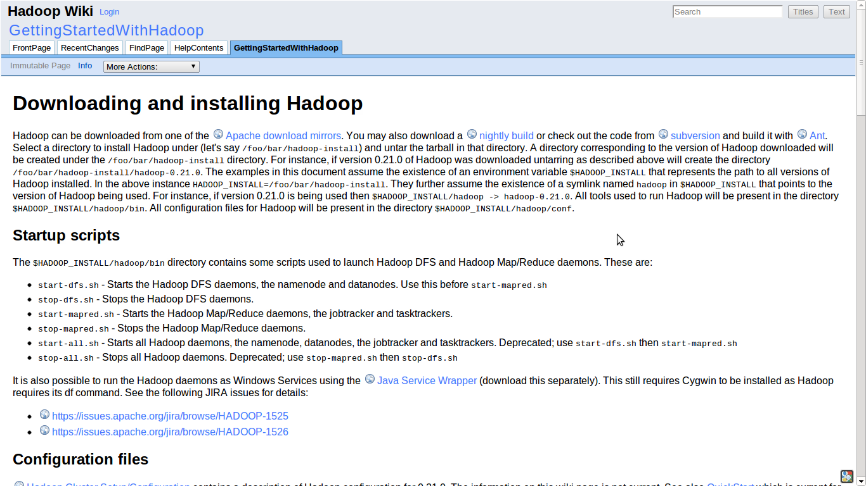

Slide 3
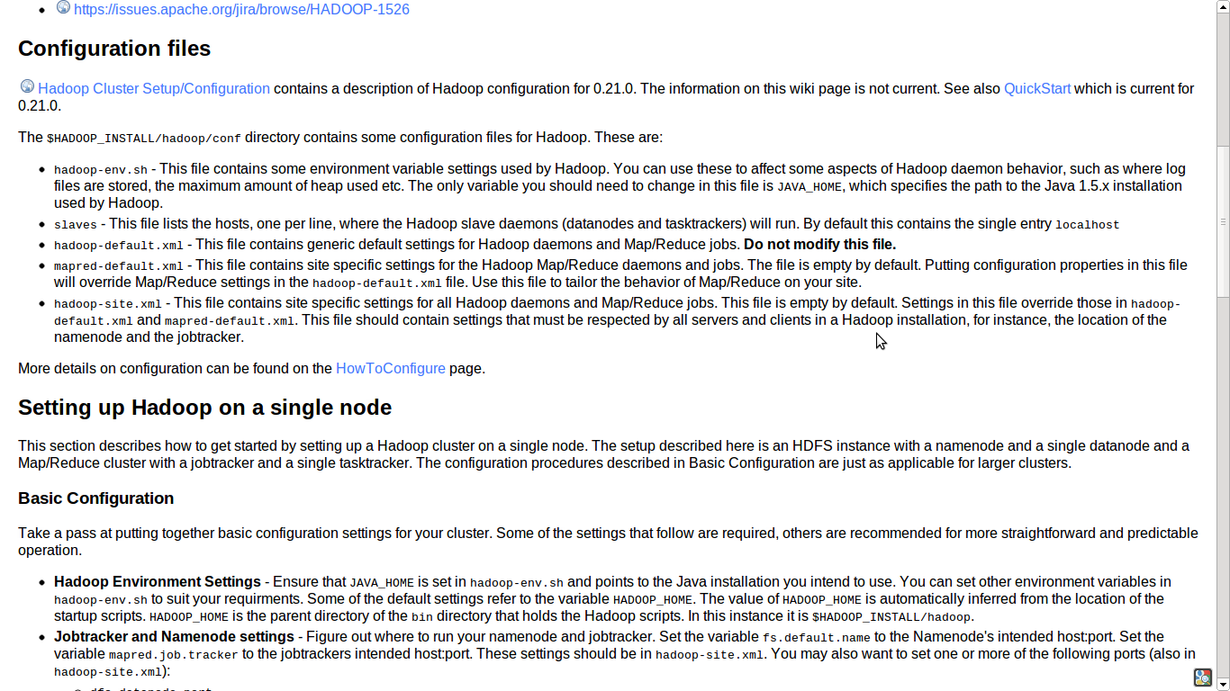

Slide 4
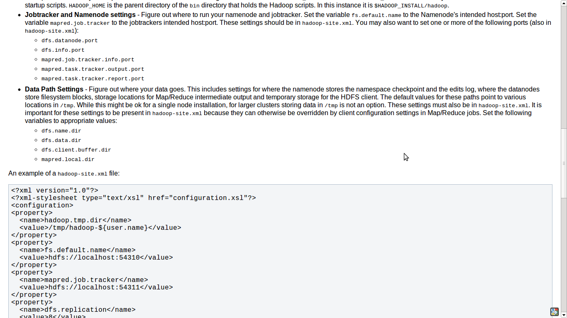

Slide 5
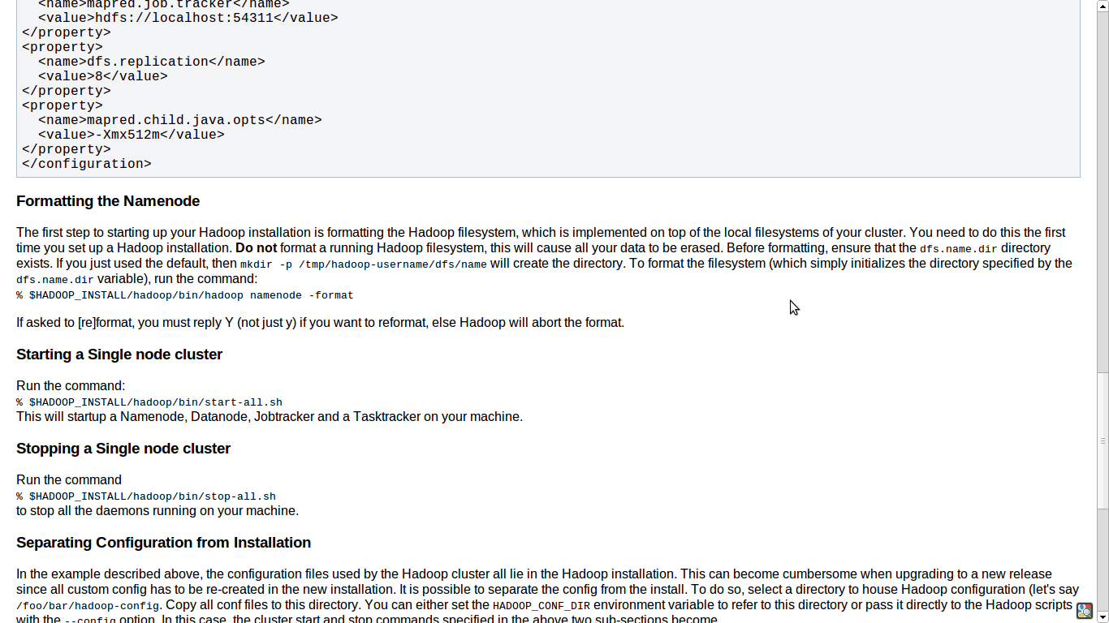

Slide 6
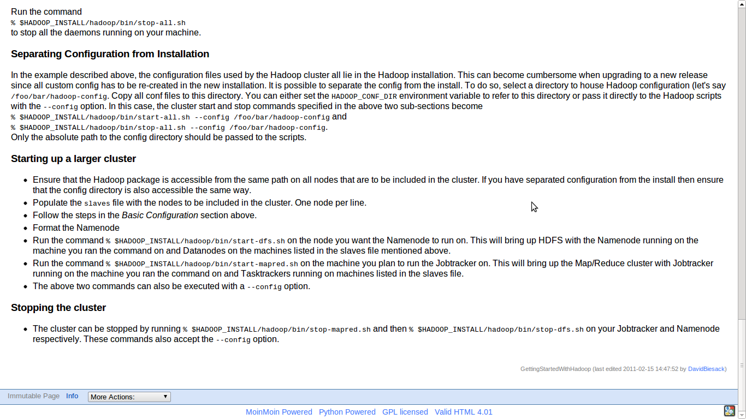

Slide 7
$ juju bootstrap
$ juju deploy hadoop-master
$ juju deploy hadoop-slave
Notes:
How did I do that! (OMG)

Slide 8
Juju Manages Services, not Machines
Devops Distilled
Notes:
We take your expertise and distill it into Juju Charms
Higher level than configuration management.
Only do things once, don't repeat yourself.
Don't repeat others.
Best practice out of the box.
Think of it like an API layer for your deployment.
No restriction on how you want to deploy

Slide 9
Service
Orchestration
Configuration
Management
Virtualization
Operating
System
Hardware

Slide 10
Relating services
Notes:
Deployment is easy, a big deal problem, lots of VC there.
BUT You're not done!!!! This is where the meat is.
You don't need to spend all this time investigating how the different parts fit together.
And test it fucking around, just get it done.

Slide 11
$ juju bootstrap
$ juju deploy hadoop-master
$ juju deploy hadoop-slave
$ juju add-relation hadoop-master hadoop-slave

Slide 12
Services
Services change during their lifetime:
          Number of instances?
          Which machines they run on?
          What services they depend on?
          And how those services are implemented?

Slide 13
Relations
A high-level interface describing the interactions between services
Services have `provides` and `requires` interfaces
Juju models the relationship between services, not machines

Slide 14
Charm
Reusable, codified best-practice.
Distilled deployment expertise.
Communication via interfaces.
Doesn't require foreknowledge of who will use them or how

Slide 15
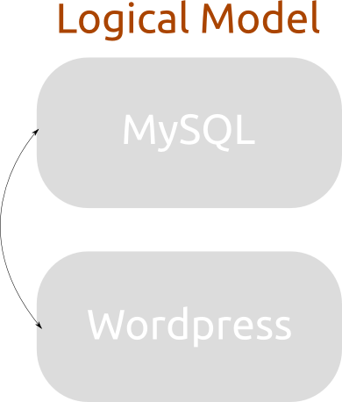

Slide 16
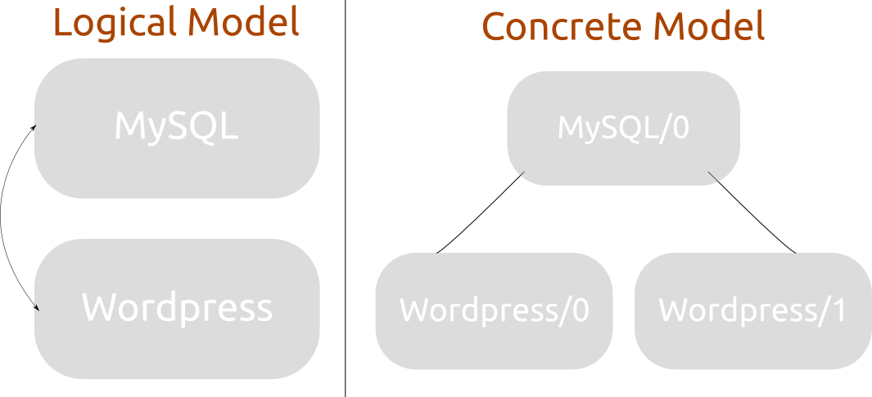

Slide 17
Scaling services

Slide 18
$ juju bootstrap
$ juju deploy hadoop-master
$ juju deploy hadoop-slave
$ juju add-relation hadoop-master hadoop-slave
$ juju add-unit hadoop-slave

Slide 19
$ juju bootstrap
$ juju deploy hadoop-master
$ juju deploy hadoop-slave
$ juju add-relation hadoop-master hadoop-slave
$ juju add-unit hadoop-slave
$ juju add-unit hadoop-slave

Slide 20
$ juju bootstrap
$ juju deploy hadoop-master
$ juju deploy hadoop-slave
$ juju add-relation hadoop-master hadoop-slave
$ juju add-unit hadoop-slave
$ juju add-unit hadoop-slave
$ juju add-unit hadoop-slave

Slide 21
Tools, boring.
Expertise, priceless.

Slide 22

Juju
Juju treats individual services as atoms that are described as formulas and can be instantiated one or many times.
Juju environment
Cloud app
Cloud app
Cloud app
and dependency solver

Slide 23
Juju
Load
Balancer
HAProxy
Each formula (or atom) define dependencies and/or provides.
Depends
Provides
Juju environment
Cloud app
Cloud app
Cloud app
and dependency solver
Provides
Depends
SQL Database
MySQL

Slide 24
Juju
Load
Balancer
HAProxy
Varnish
Multiple formulas can provide the same service and can be easily switched.
Depends
Provides
Juju environment
Cloud app
Cloud app
Cloud app
and dependency solver
Provides
Depends
SQL Database
MySQL

Slide 25
Juju
Varnish
Varnish
Juju maintains the relations between the services so that you don't need to care about the elasticity of your environment.
Relations are to formulas what bounds are to atoms.
Services are loosely coupled but highly cohesive.
Juju Relation
Juju environment
Cloud app
Cloud app
Cloud app
and dependency solver
Juju Relation
MySQL
MySQL
MySQL

Slide 26
Juju
Varnish
Juju delivers service focused management through their life-cycle
Offers the same simple rules to components of you infra as we do already for packages on your servers: dependencies, provides
Adds the notion of dynamic relations between components
To provide you with simple automated elasticity that is easy to expand
Working on your bare metal servers (through Orchestra*) as easily as on your favourite clouds (AWS, OpenStack*, ...)
Juju Relation
Juju environment
Cloud app
Cloud app
Cloud app
and dependency solver*
Juju Relation
MySQL
MySQL
*coming soon

Slide 27
A Community of Charms
Devops Distilled
Notes:
Upstreams, get your code out to ops faster
Ship best practice by default
In whatever language you want
“Lego(tm) for the Cloud”
Reuse formulas built by others

